Slide 1
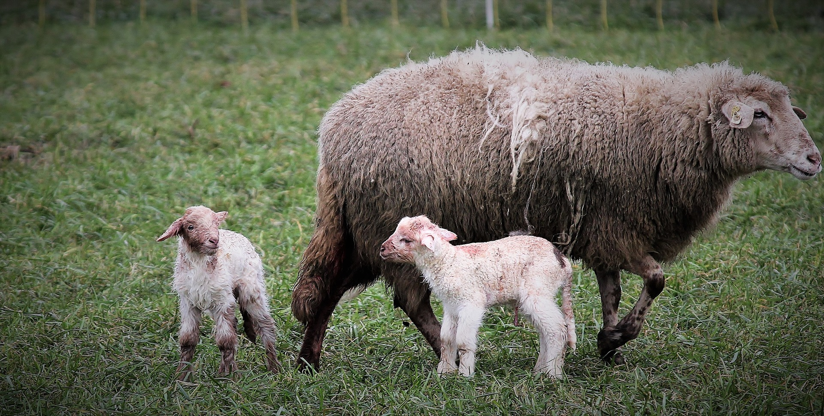
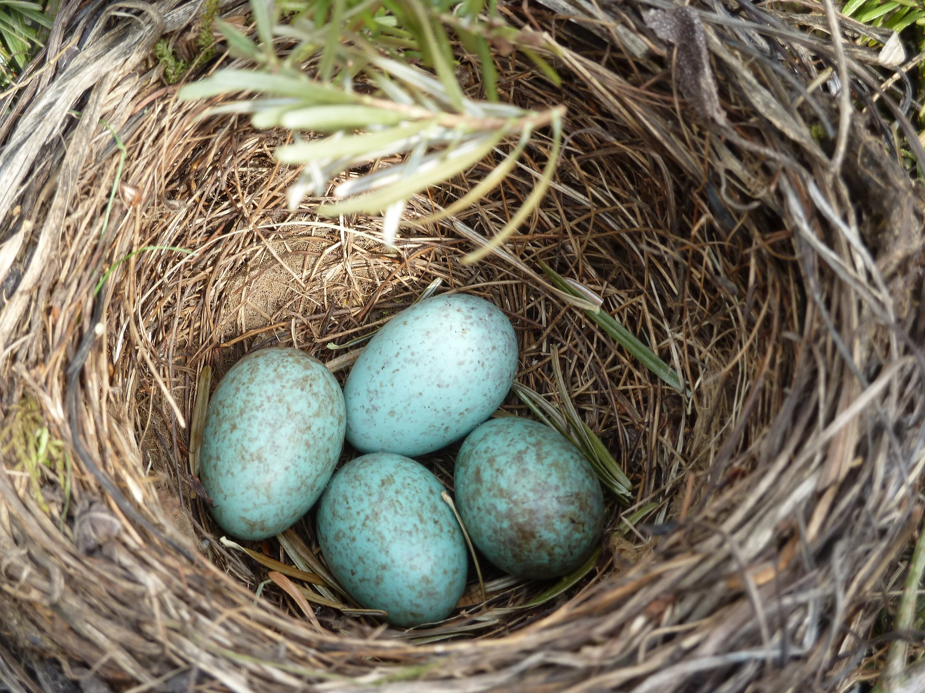
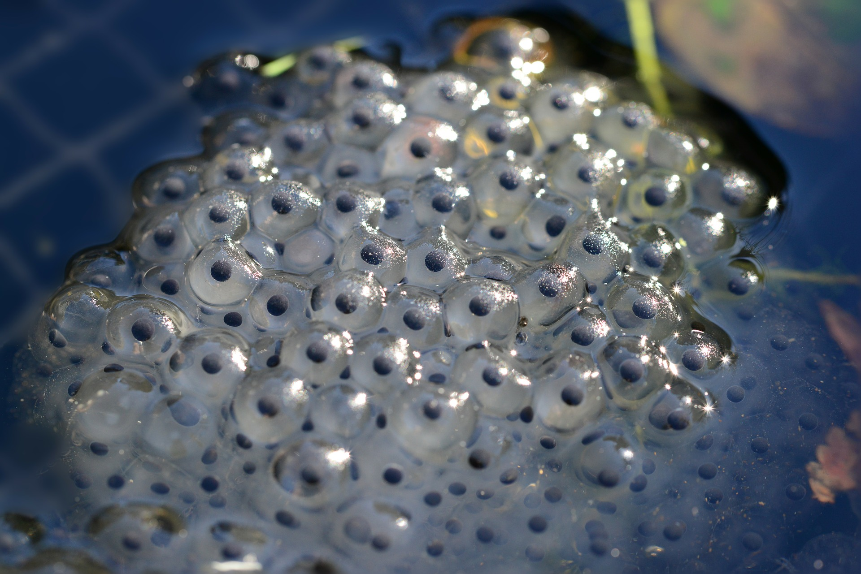
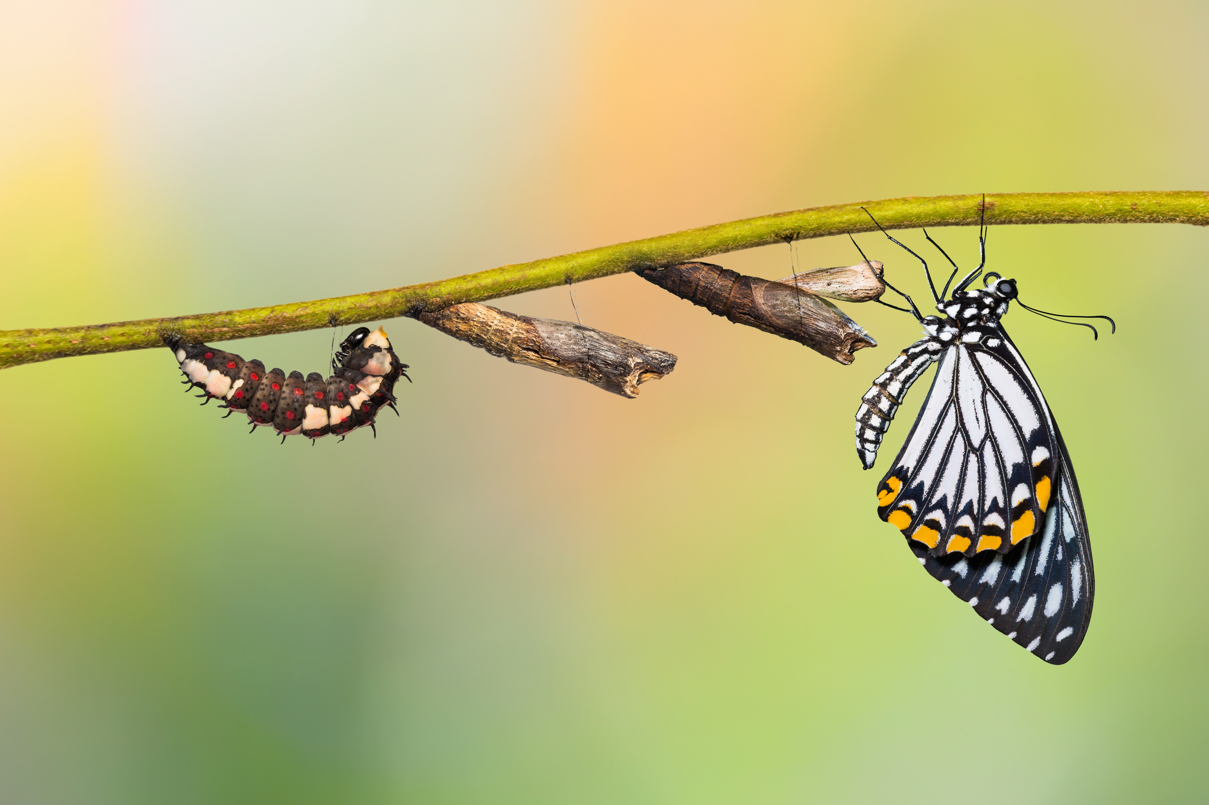
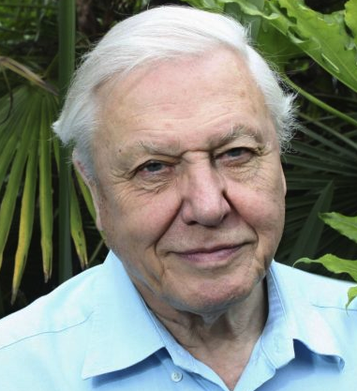
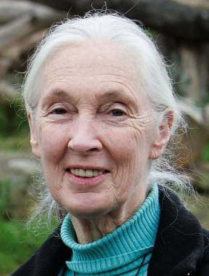
Living things that reproduce asexually include bacteria, mould, algae and fungi.
This means they reproduce by themselves!
Knowledge Organiser
Studying Living Things
Can you remember?
All living things can: move, respire, have senses, grow, reproduce, excrete and take in nutrition.
ROCKET WORDS Learn these words and their definitions.
Key Word | Definition
 | A natural scientist who has made many award-winning nature documentaries
 | A scientist who committed her life to studying the lives of chimpanzees and other primates.
 | An expert in natural sciences and history.
 | When insects and animals develop into adult forms through a cycle of changes.
 | A species of animal with very few alive.
 | A film or programme that researches, studies and provides a factual report on a subject.
 | Something that reproduces on its own.
 | To make offspring.
Vocabulary
Animals and birth
Most mammals, including humans, go through ‘live birth.’ This means that the mother gives birth to it as a live mammal,
it is just a smaller version of an adult.
These mammals will grow into adults over time.
Documentary
Endangered
Naturalist
Metamorphosis
Asexual
Reproduction
Jane Goodall
Sir David Attenborough
Most birds and reptiles are born when the mother lays eggs and incubates them until they are ready to hatch. Once the egg is hatched, the baby is looked after by the mother for a period of time, and then leaves the nest to fend for itself.
Amphibians are a bit different. Many of these are born live or via eggs underwater, but complete a metamorphosis as adults and can live and breathe on land. An example of this is a frog. It starts as frogspawn, changes to a tadpole and then into a frog!
Sir David Attenborough and Dame Jane Goodall
chrysalis
butterfly
larva
Both Sir David Attenborough and Dame Jane Goodall are leading naturalists, and study living things. They both present the life of animals on earth and have made important documentaries so we can learn about the world around us.
Because of their impact on the world, they have both been awarded honours by the Queen!
metamorphosis

