Slide 1
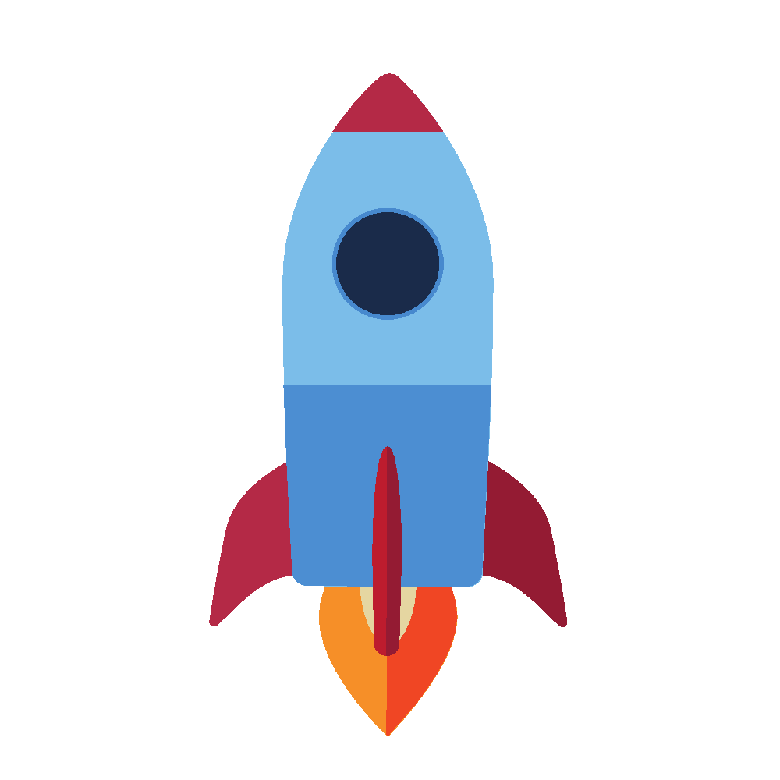
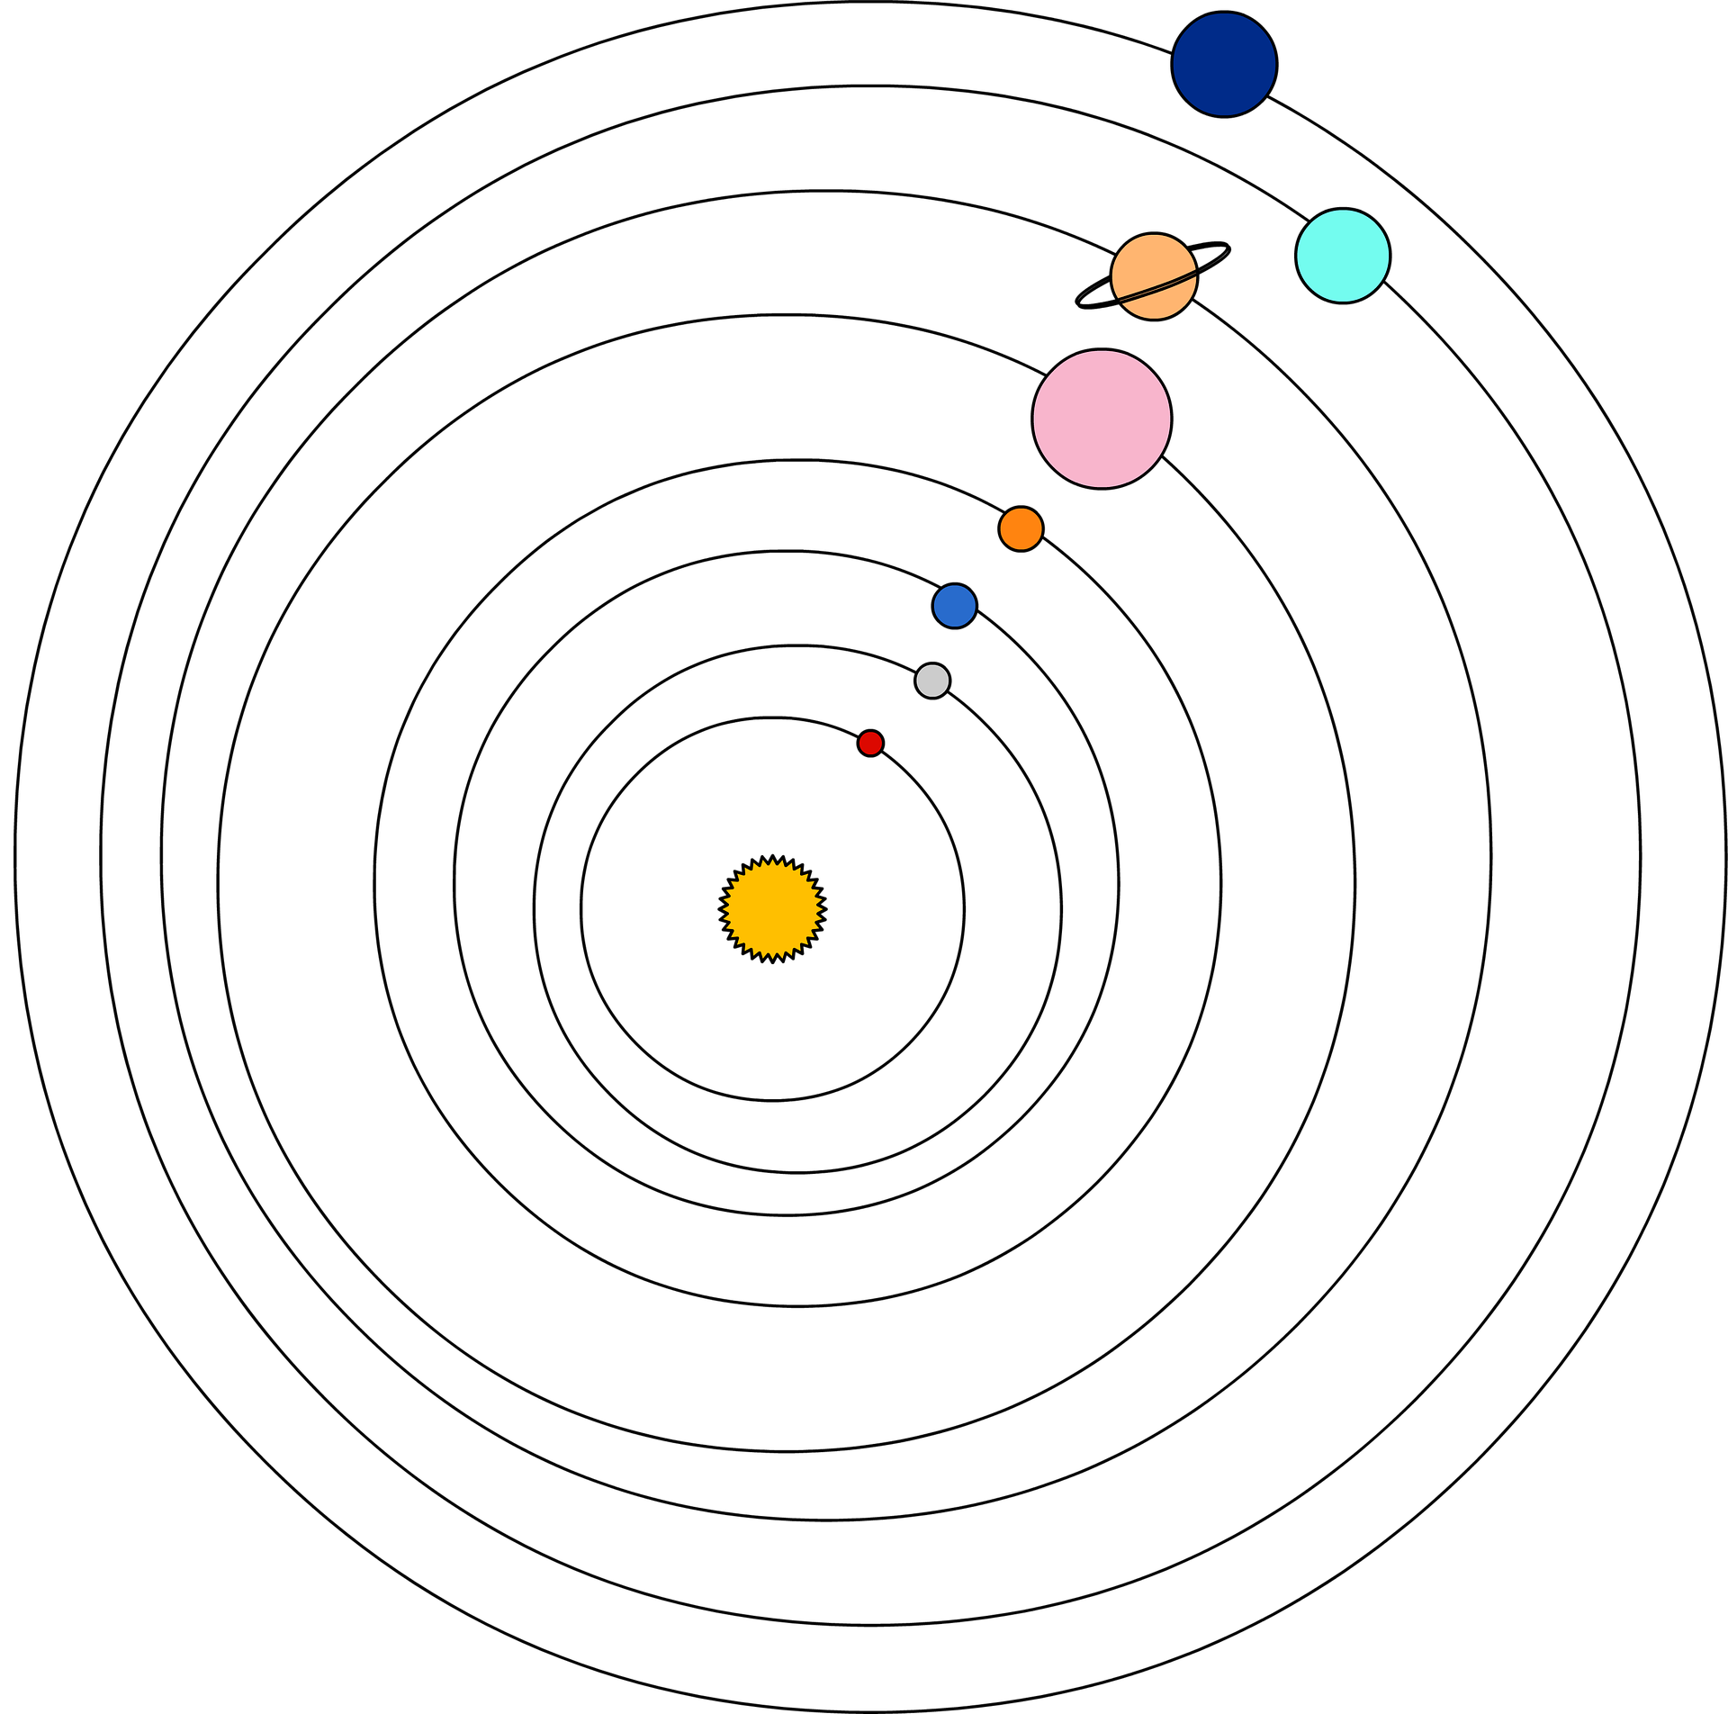
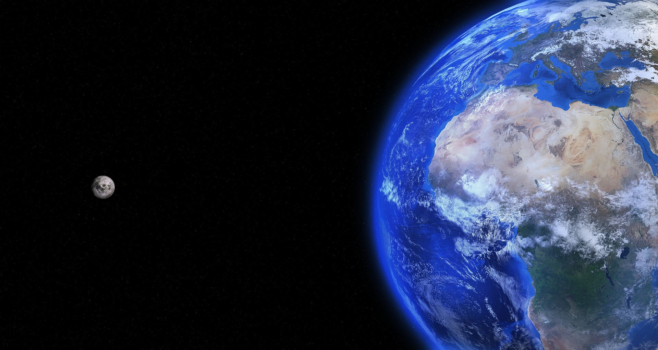
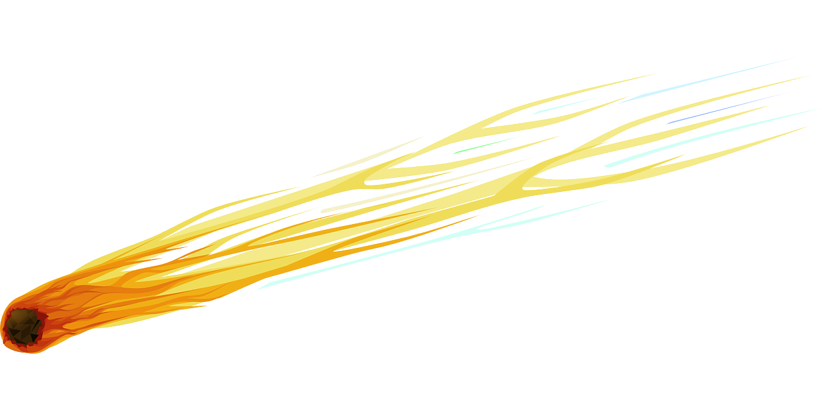

It takes the Earth 365.25 days to orbit the sun, which is why every four years we have a leap year of 366 days, to catch up with the orbit!
Knowledge Organiser
Earth and Space
The Earth takes 24 hours to spin on its axis and complete one rotation, which is why our days are 24 hours long.
ROCKET WORDS Learn these words and their definitions.
Key Word | Definition
 | The modern model of the solar system, which places the sun at the centre.
 | The old solar system model, which thought the Earth was at the centre.
 | The name for the sun and all the planets, asteroids, meteors and comets that orbit it.
 | The study of space, planets and the universe as a whole.
 | The most widely accepted scientific theory of how the Universe was made.
 | The force that causes two particles to pull towards each other.
 | The path of one celestial object around another i.e. the Moon around the Earth.
 | On Earth, there are two of these – the North and South, separated by the equator.
FROM THE SUN OUTWARDS:
Mercury
Venus
Earth
Mars
Jupiter
Saturn
Uranus
Neptune
Put these keywords next to the correct definition
Gravitational force
Solar system
Geocentric
Astronomy
Heliocentric
Big Bang Theory
Orbit
Hemisphere
This diagram is a good, simple way to remember the order of the planets and also to understand planetary motion and the way the planets orbit the sun. Copernicus developed the heliocentric theory that the sun was at the centre of the solar system. However, the ellipses-shaped orbit was an idea that was discovered by Johannes Kepler in the 17th century.
Gravitational force
Comets, meteors and asteroids
The moon orbits the earth at the same distance due to gravitational force. This is why we can send satellites in to space without them floating away! The Earth’s gravity and magnetism pulls the moon towards it.
All three of these are bodies of rock in the solar system. Comets are made of ice, rock and dust and have a tail following it. Meteors are masses of rock that fly through space like a fiery streak. Some enter the Earth’s atmosphere but usually burn up!
Asteroids are similar but much larger and can be found in the asteroid belt between
Mars and Jupiter.

