Slide 1
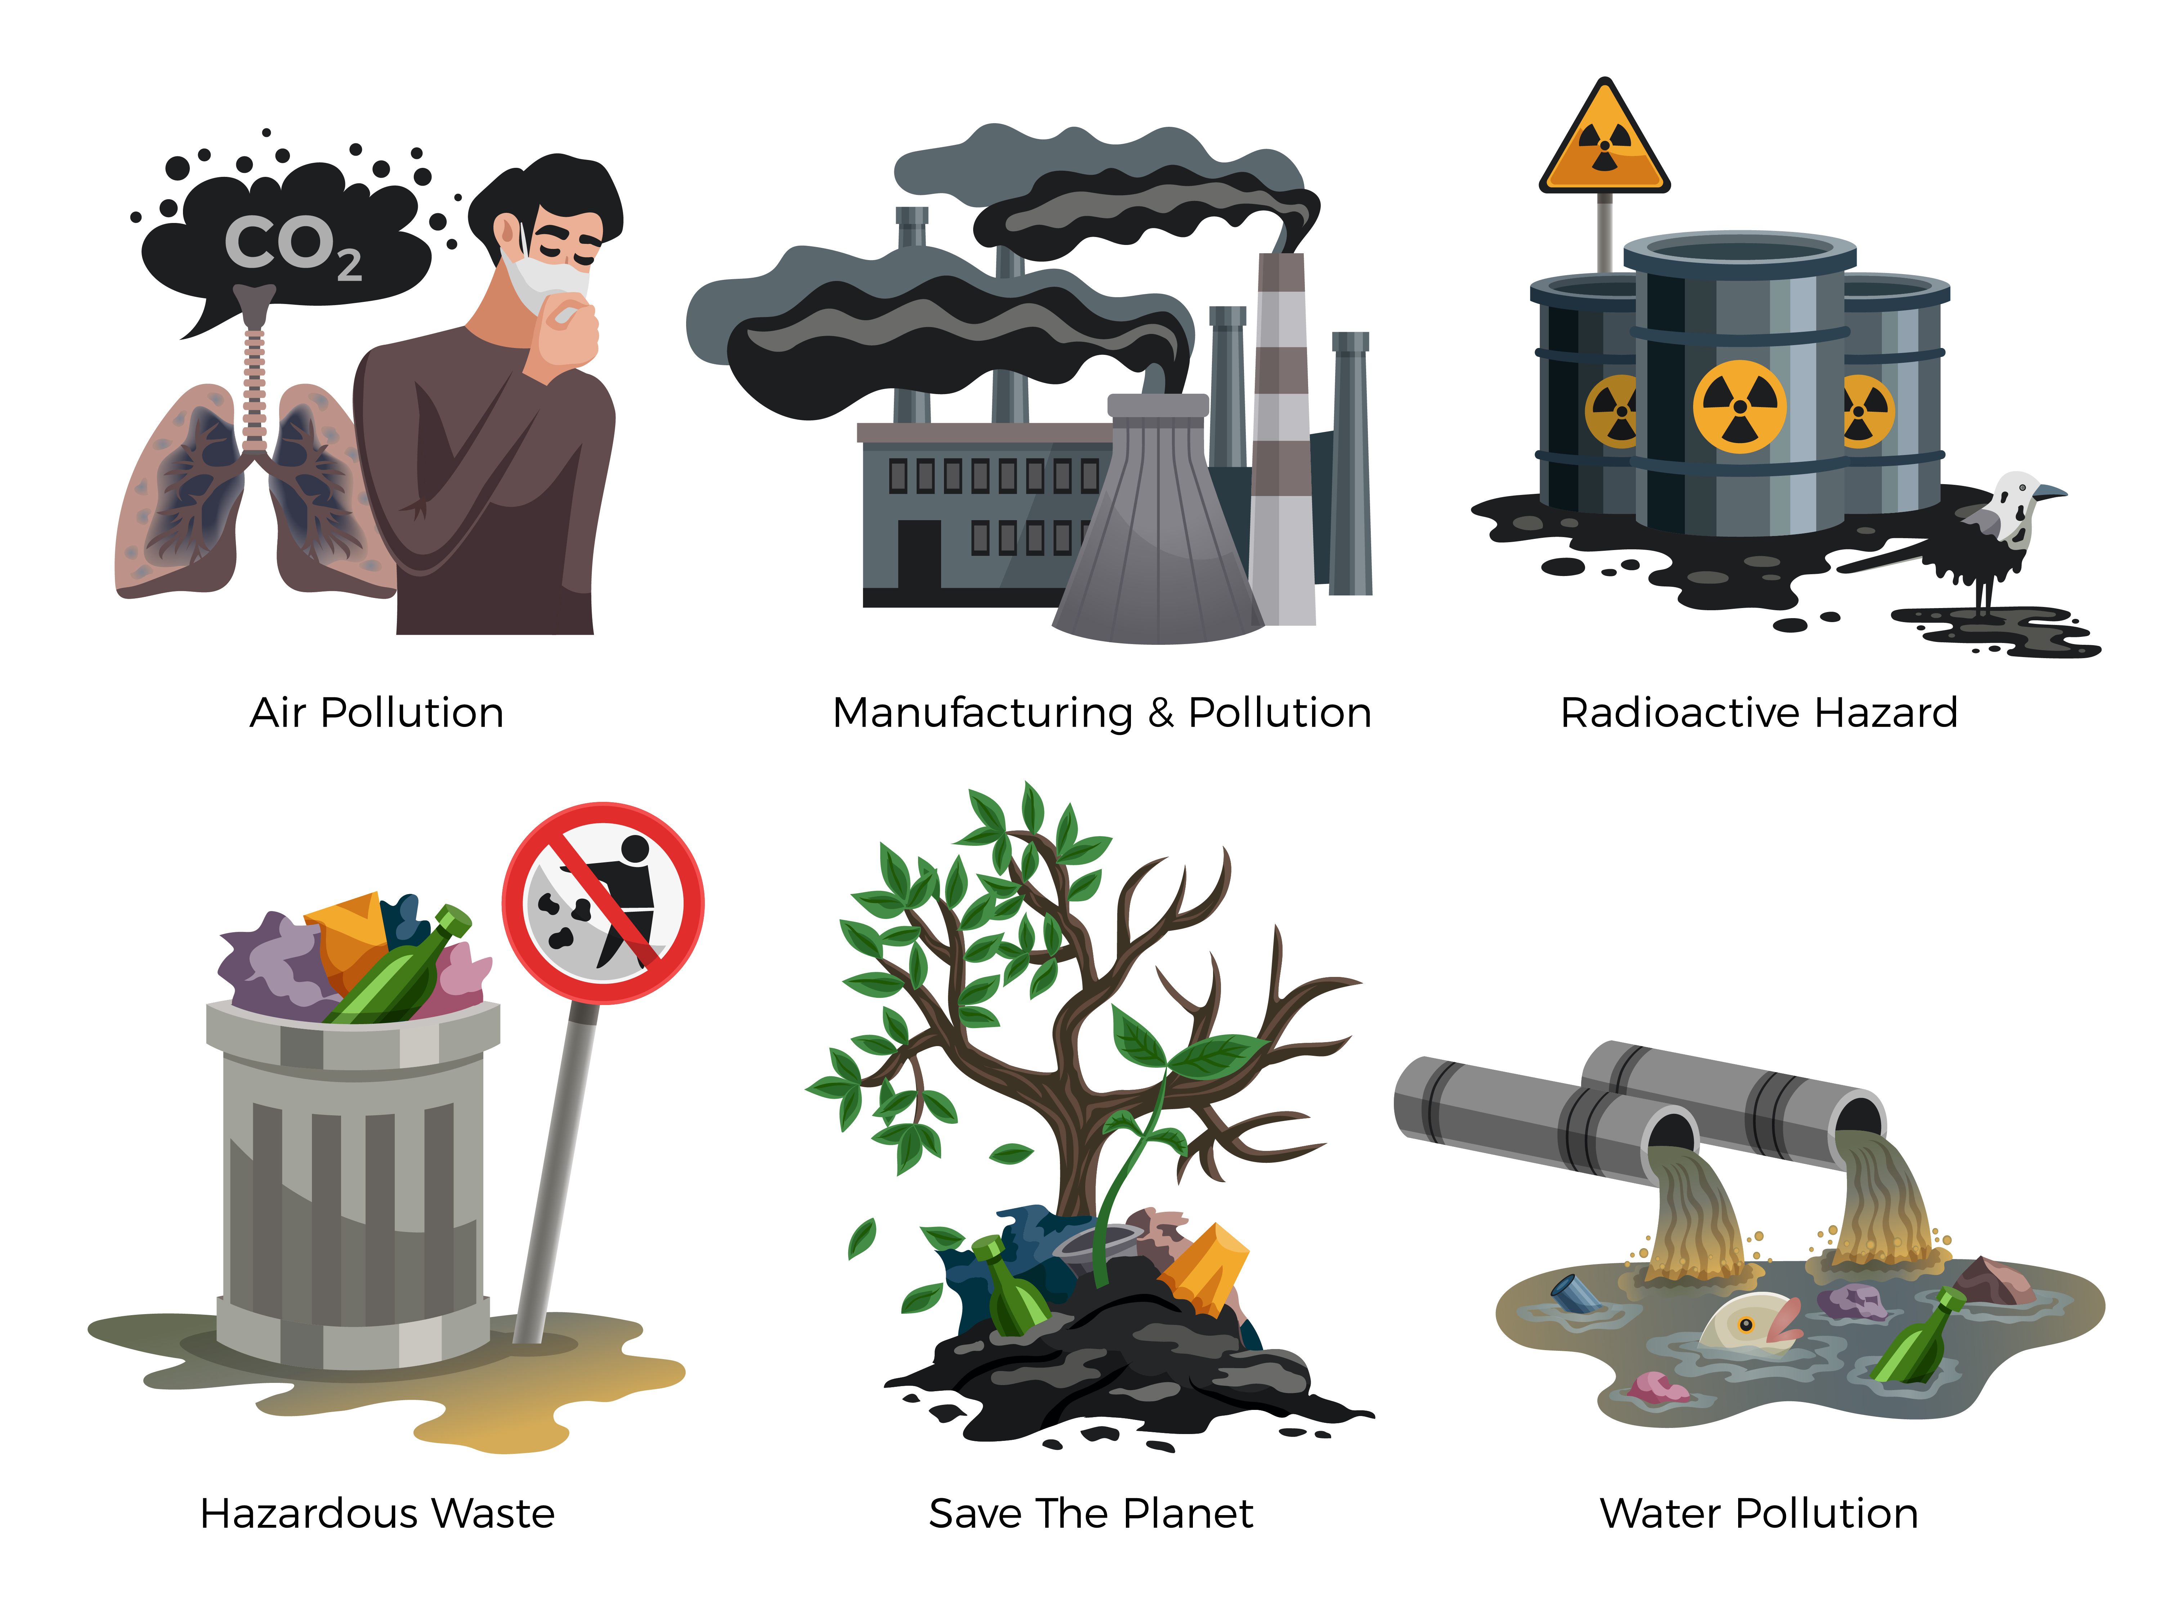
Did you know that around 450 million litres of water are wasted each year in the UK?
Knowledge Organiser
Living things and their habitats:
Nature and the environment
It is estimated that the world’s reserves of oil and gas could run out
in the next 50 years.
ROCKET WORDS Learn these words and their definitions.
Key Word | Definition
ecology | A type of science which looks at the relations between different organisms and their environments.
interdependent | When two or more things are reliant on each other for survival.
ecosystem | A community of organisms that interact with each other within their environment.
environment | The surroundings or conditions in which we live.
pollute | To damage something natural with harmful substances.
chemical | A substance which has been artificially prepared for a purpose.
habitat | The natural home of an animal or plant.
emission | This release of something, such as gas, into the atmosphere.
NIT LESSONS
1
2
Understand ecosystems and how they are affected by changes in the environment
3
Understand man’s impact on the environment
4
5
6
Know about air pollution; know how we can help protect the environment
Understand water pollution
Explore methods that can be used to conserve water
Know about the balance of nature
Air pollution
Manufacturing & Pollution
Deforestation
Hazardous
Waste
Radioactive Hazard
Water Pollution
Five top tips for helping to save the planet!
Re-use and recycle plastic items.
Turn off taps and only use the water you need.
Fully switch off lights and electrical items.
Encourage the use of renewable energy sources.
Walk, cycle or use public transport.

