Slide 1

Our Curriculum
The National Curriculum is concise and sets out the core knowledge that pupils should acquire. It states that pupils need to be ‘ready for the next level of their learning at secondary school’.

Slide 2

Our curriculum:
Develops the whole child
Has clear progression in subject knowledge, skills and understanding
Is rich in written and spoken language.
Develops critical thinking, deepening understanding and enables children to develop positive attitudes to learning.
Uses a range of enquiry questions to develop understanding.
Encourages children to aspire to achieve highly.
Offers purposeful experiences
Assessment:
Each year group has clear end of year expectations. Pupils are expected to know, apply and understand the matters, skills and processes specified.

Slide 3
Your child will be assessed against the expectations at the end of each year group. This will be defined and reported to you in the following way:
Emerging – A child who is beginning to access the curriculum appropriate for their age with some level of support. They do not yet meet the expected year group expectation.
Expected - A child who is working at an age related level and has achieved the expectation for the year group.
Exceeding – A child who is working beyond the expectation for their particular age.
The next pages inform you of your child’s year group expectations which they will be assessed against.
Please be aware that each year group has different and progressively harder expectations. Your child may start each new academic year at the emerging expectation.

Slide 4
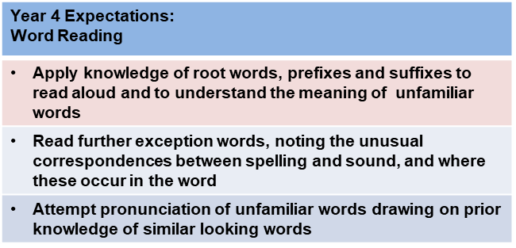
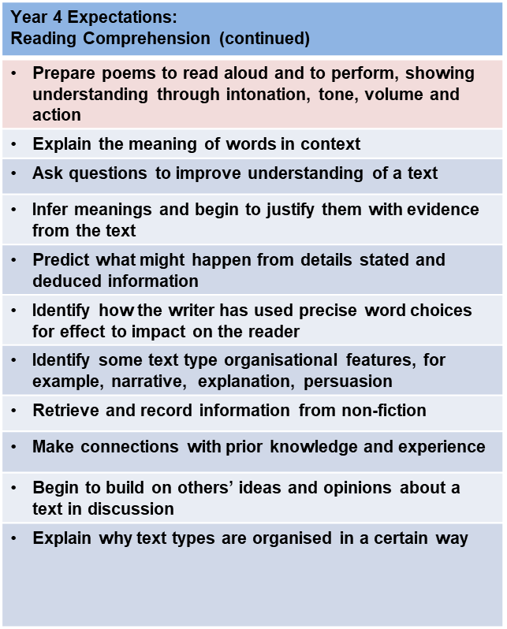
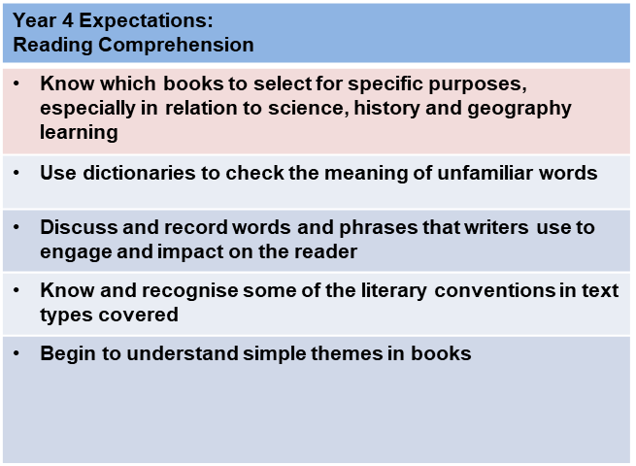
Assessing Reading
Meeting Year 4 Expectations

Slide 5
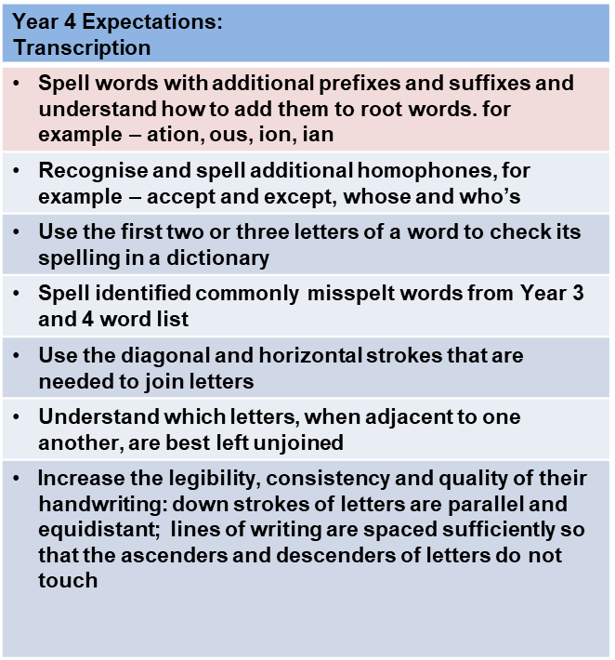
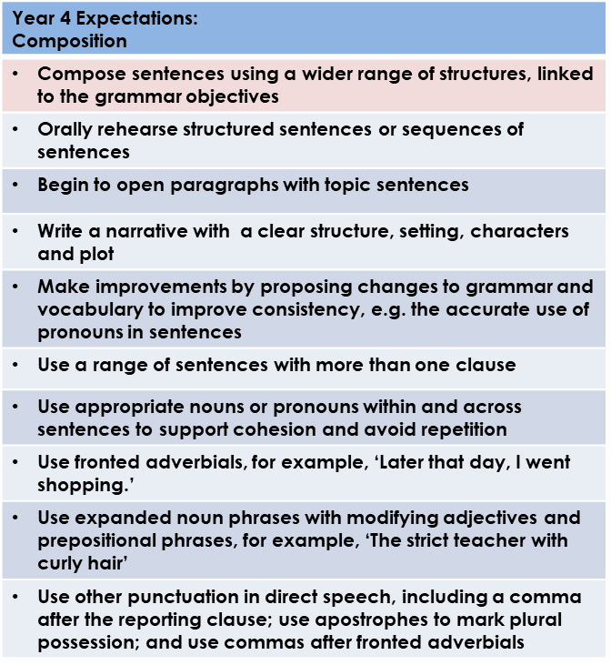
Assessing Writing
Meeting Year 4 Expectations

Slide 6
Assessing Spoken Language
Meeting Year 4 Expectations
Year 4 Expectations: Spoken Language
Ask questions to clarify or develop understanding
Sequence, develop and communicate ideas in an organised, logical way in complete sentences as required
Show understanding of the main points and significant details in a discussion
Increasingly adapt what is said to meet the needs of the audience/listener
Vary the use and choice of vocabulary dependent on the audience and purpose
Show understanding of how and why language choices vary in different contexts
Present writing to an audience, using appropriate intonation and controlling the tone and volume so that the meaning is clear
Justify answers with evidence
Understand when the context requires the use of Standard English
Perform poems or plays from memory, conveying ideas about characters and situations by adapting expression and tone

Slide 7
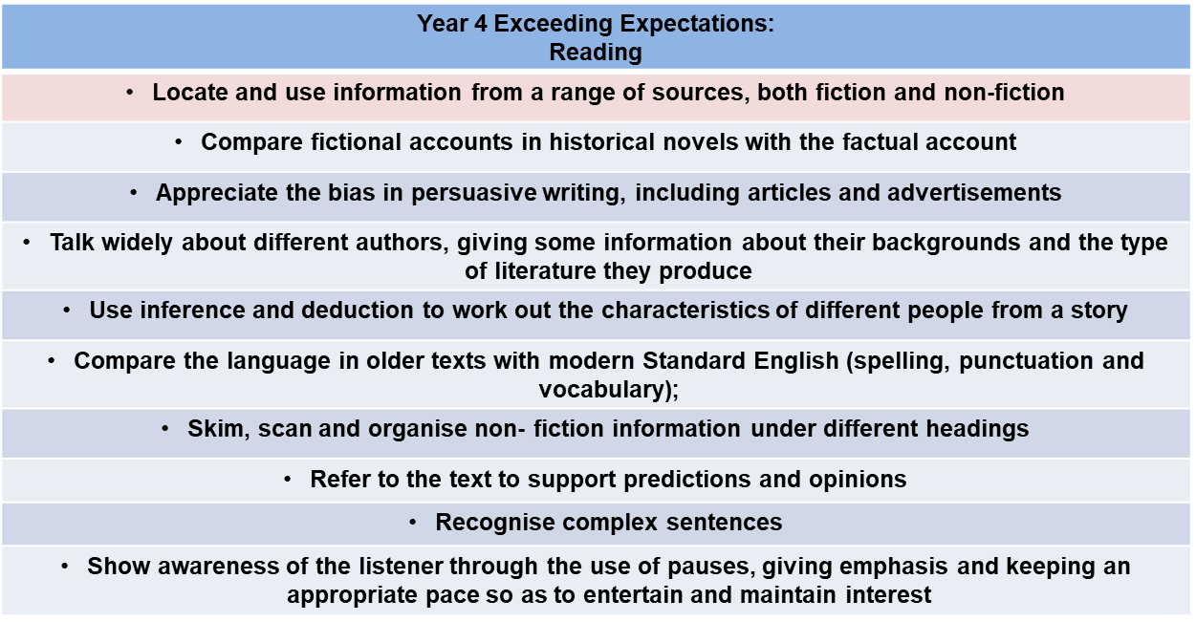
Assessing Reading
Exceeding Year 4 Expectations

Slide 8
Assessing Writing
Exceeding Year 4 Expectations
Year 4 Exceeding Expectations: Writing
Prepared to carry out a little research to find words that are specific to the event being written about
Check to see if there are any sentences that can be re-organised so as to give my writing a greater impact
Consciously use short sentences to speed up action sequences
Use dialogue and reactions from other characters to make my character interesting
Recognise when a simile may generate more impact than a metaphor, and vice versa
Recognise when it is reasonable to allow direct speech to tell the reader more about an individual’s personality
Recognise that a combination of good adjectives, similes and metaphors may help create a powerful image of the characters I am writing about
Know how to re-order sentences so that they create maximum effect
Vary choice of pronouns correctly to refer to the first, second and third person, both singular and plural
Use commas or ellipses in order to create greater clarity and effect in my writing

Slide 9
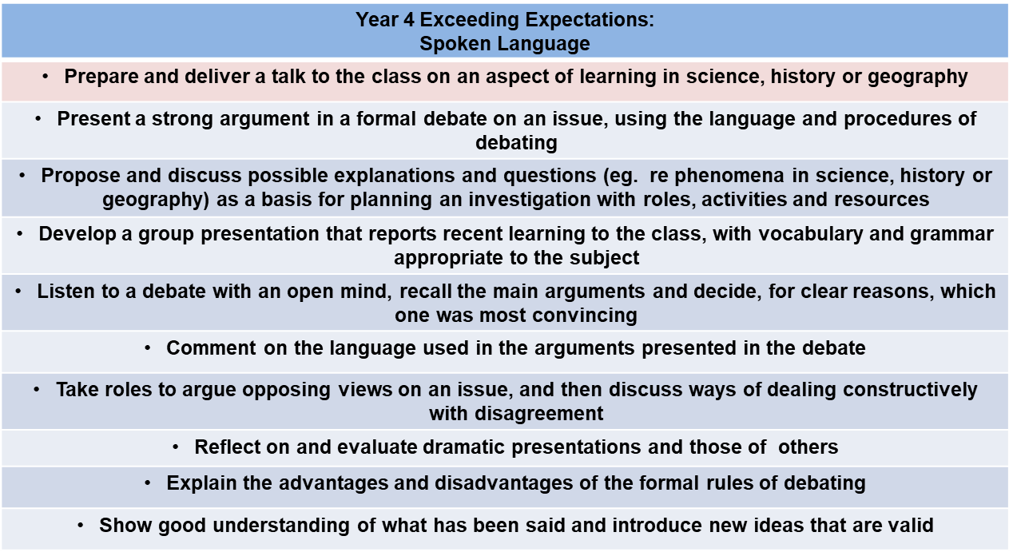
Assessing Spoken Language
Exceeding Year 4 Expectations

Slide 10
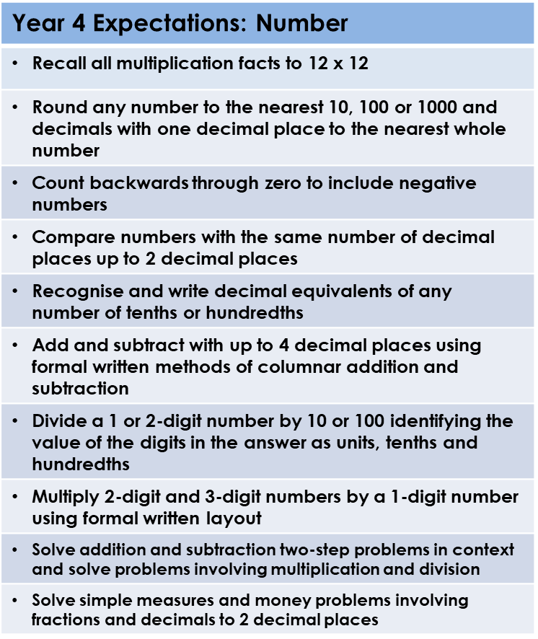
Assessing Mathematics
Meeting Year 4 Expectations

Slide 11
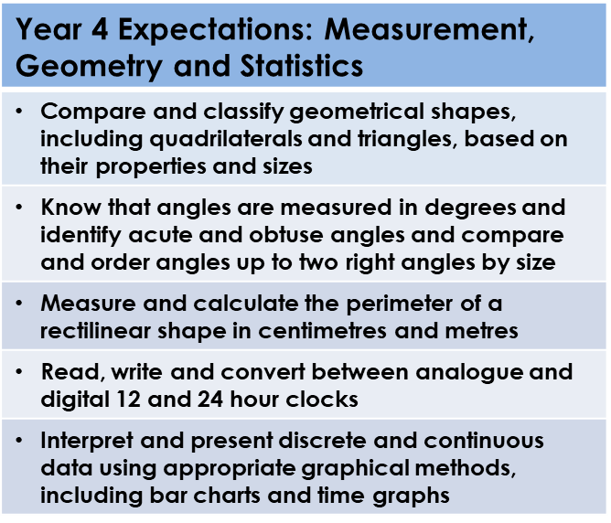
Assessing Mathematics
Meeting Year 4 Expectations (continued)

Slide 12
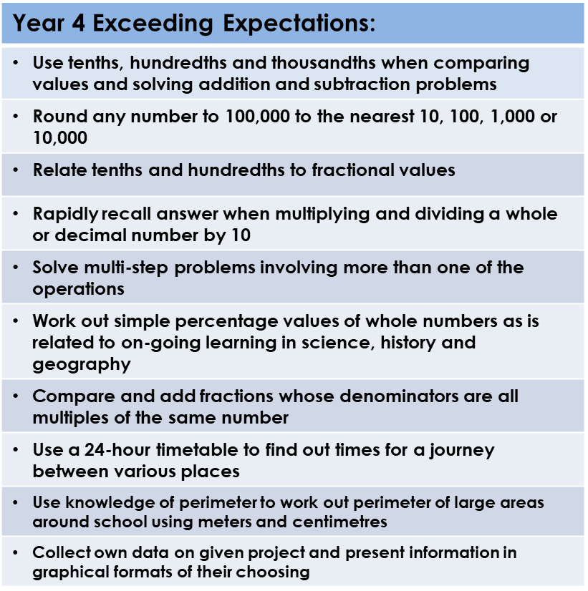
Assessing Mathematics
Exceeding Year 4 Expectations

Slide 13
Assessing Science
Meeting Year 4 Expectations
Pupils at the expected level of attainment at the end of Year 4 will be able to
Working Scientifically
Ask relevant questions and use different types of scientific enquiries to answer them by:
Setting up simple practical enquiries, comparative and fair tests.
Making systematic and careful observations, taking accurate measurements using equipment including thermometers and data loggers.
Gathering, recording and classifying and presenting data in a variety of ways.
Recording findings using scientific language, drawings, labelled diagrams, keys, bar charts and tables.
Reporting on findings, using oral or written displays and presentations which include results and conclusions.
Using results to draw simple conclusions, make predictions, suggest improvements and raise further questions.
Identify differences, similarities or changes related to simple scientific ideas and processes.
Use straightforward scientific evidence to answer questions or to support their findings.

Slide 14
Assessing Science
Meeting Year 5 Expectations
Pupils at the expected level of attainment at the end of Year 4 will be able to:
Name and describe the functions of the main parts of the digestive system.
Construct and interpret food chains.
Explain how environmental changes may have an impact on living things.
Describe the characteristics of different states of matter and how materials change state at different temperatures. Relate these changes to the water cycle.
Explain how sounds are made and heard, understanding that they are associated with vibrations and need a medium to travel through.
Describe the link between the pitch of a sound and its source and the volume of a sound the strength of the vibrations and the distance from its source.

Slide 15
Assessing Art and Design
Meeting Year 4 Expectations
Pupils at the expected level of attainment at the end of Year 4 will be able to:
Pupils begin to show facial expressions and body language in their sketches.
They are able to use colour and shading to create mood and feeling in paintings and drawings.
They can use line, tone, shape and colour to represent figures and forms in movement.
Pupils can make choices about the materials they draw with and explain their choices. Pupils can create an accurate print design using at least four colours.
Pupils experiment with and combine materials and processes to design when working with 3D forms, textiles, and collage.
Pupils use sketchbooks to express feelings about various subjects and outline likes and dislikes. They use sketchbook to adapt and improve on their original ideas and they keep notes on the purpose of their work.
Pupils can use IT to make presentations of their work and they can combine graphics and text based on their research.
Pupils can experiment with styles which artists have used and discuss art form other periods in history.

Slide 16
Assessing Computing
Meeting Year 4 Expectations
Pupils at the expected level of attainment at the end of Year 4 will be able to:
Use a safe search engine to find relevant facts, comparing different websites to check. They will change the font face, size and colour of text to create effects, re-size and rotate images, change the page background and add borders. Pupils will add and find items in a prepared database and create a bar chart. They will create a presentation about a topic using pictures and text and include slide transitions and animations.
Programming
Pupils will break up coding problems into smaller parts, testing and debugging their sequences as they go along. They will use programming commands to achieve specific goals and use repeat commands. They can recognise errors in programs and debug them.
E-safety
Explain what makes a good password and keep their online information private. Use websites safely, report issues to an adult and recognise websites and games that are age appropriate. They are kind and considerate online and post positive comments. They understand that anything they post online can be seen by others.
Photography
They will take digital photographs and videos with a suitable device.

Slide 17
Assessing Design and Technology
Meeting Year 4 Expectations
Pupils at the expected level of attainment at the end of Year 4 will be able to:
Design and Evaluate:
Generate designs and simple step-by-step plans for their purposeful product and explain it to others.
Create a simple template for their design e.g. shape in card to cut around their choice of textile.
Develop their ideas by changing and improving a product during the design and making process to improve it.
Evaluate their ideas and products against a design criteria within a function or user in mind, considering the products appearance and explain how it works.
Cooking and Nutrition:
Pupils use their tools and equipment with a good level of expertise and independence.
Explain and practice how to be safe and hygienic when using tools and equipment.
Consider how to present their food in an interesting way e.g. patterns, displayed.

Slide 18
Assessing Design and Technology
Meeting Year 4 Expectations
Pupils at the expected level of attainment at the end of Year 4 will be able to:
Textiles:
Select from a range of textiles for a user and what they would want and need out of the product.
Pupils will use different joining techniques with their textiles such as gluing, stitching etc.
Electrical and Mechanical Components:
Explore and use a product that has electrical or mechanical components such as improving a simple circuit by adding another element such as a buzzer or light.
Stiff, Flexible and Mouldable Materials:
Select from a wide range of materials, measuring carefully and accurately to try and not make mistakes when cutting, joining or covering.
Use a range of techniques to mould and shape mouldable materials such as rolling and squashing clay, editing it along the way to improve it.
Explain to others how they have attempted to make their product stronger using their selected materials.

Slide 19
Assessing History
Meeting Year 4 Expectations
Pupils at the expected level of attainment at the end of Year 4 will be able to:
Demonstrate both knowledge and understanding of history through identifying and explaining some of the ways that significant individuals and events during Anglo Saxon rule contributed to shaping life in present day Britain, why the Vikings wanted to invade and what impact they had in Britain.
In doing so they use an increasing range of basic and more specialised subject vocabulary accurately and show that they can synthesise information from a broader range of historic sources including artefacts to help formulate their explanations.
They will be able to make insightful links between their different enquiries to compare and contrast life in Britain at different times and offer sound historic reasons for the similarities and differences they observe. As they do this they will show an understanding of key historical concepts such as continuity and change, cause and effect and significance.
Through a study of ancient Egypt they will be able to order, describe and explain the stages of entry into the afterlife shown in the wall murals of Tutankhamun’s tomb. They will also be able to suggest reasons why archaeologists sometimes disagree about what historical evidence tells us.

Slide 20
Assessing Geography
Meeting Year 4 Expectations
Pupils at the expected level of attainment at the end of Year 4 will be able to:
Demonstrate geographical understanding by describing and explaining in basic terms the similarities and differences in the physical and human features of their home area and a region in North America, including offering some reasons why both places are changing.
They will be able to locate, describe and explain some of the reasons for the distribution of globally important physical and human geographical features including climate zones, deserts, tropical rain forests, earthquakes and the world’s largest urban areas.
They will also be able to identify, describe and explain the significance on a world map and globe of important lines of latitude and longitude, the Northern and Southern Hemisphere, the Tropics of Cancer and Capricorn together with the Artic and Antarctic Circle, the Greenwich Meridian and Times Zones.
In achieving the above pupils show they understand and apply some specialised subject vocabulary and use effectively more complex techniques to gather, present and communicate geographical information, including digital technologies, inside and outside the classroom.

Slide 21
Assessing Music
Meeting Year 4 Expectations
Pupils at the expected level of attainment at the end of Year 4 will be able to:
Performing
Sing songs from memory with accurate pitch and rhythm. They improvise using repeated patterns
They use several selected pitches at once to produce a harmony (chord).
Composing
Begin to use some standard musical notation when performing and composing, on their own or in a small group. Some children will explore and use sets of pitches (4 or 5 note scales etc.) and make their music louder or quieter to create effect.
Appraising
Identify the character and style of a piece of music and why it was written. They understand the importance of silence (rests) and begin to identify the style of pieces of music by Beethoven, Mozart and Elgar.

Slide 22
Assessing MFL (French)
Meeting Year 4 Expectations
Pupils at the expected level of attainment at the end of Year 4 will be able to:
Can give short, simple responses to what he/she sees and hears.
Can name and describe people, places and objects. Can use set phrases [for example, to ask for help and permission] Pronunciation is sometimes still approximate and delivery hesitant, but meaning is clear.
Can understand short phrases presented in a familiar context. Can match sound to print by reading aloud single familiar words and phrases. Can begin to use books or glossaries to find out the meanings of new words.
Can copy familiar short phrases correctly. Can write or word process items [for example, simple signs and instructions] and set phrases used regularly in class. When he/she writes familiar words from memory spelling is sometimes approximate.

Slide 23
Assessing Physical Education
Meeting Year 4 Expectations
Pupils at the expected level of attainment at the end of Year 4 will be able to:
Show good awareness of attacking and defending tactics
Confidently demonstrate flexibility, strength, technique, control and balance.
perform dances using a range of movement patterns
compare their performances with previous ones and demonstrate improvement to achieve their personal best.
Recognise oxygen travels to our muscles in our blood.
Know the purpose of muscles, heart and lungs and how exercise benefits them. Have an understanding of mental health
Work with others to discuss appropriate actions and solve a problem.
Complete a forward roll showing good technique
Use skills and apply tactics to retain possession in invasion games.
take part in outdoor and adventurous activity challenges both individually and within a team

Slide 24
Assessing PSHE
Meeting Year 4 Expectations
Pupils at the expected level of attainment at the end of Year 4 will be able to:
Children will manage anger and stress, positively and will start to develop strategies for resolving these feelings in particular situations. Children express feelings of compassion, empathy and sympathy in familiar situations and in discussion about what they see in the media.
Children make clear judgements and informed decisions about their emotional health and well-being and behaviour. They can identify various factors that affect emotional health and well-being and talk about positive ways to face new challenges and develop new skills. They are able to discuss some of the bodily and emotional changes that they are feeling.
Children are demonstrate with confidence that they recognise their own worth and that of others and express their views confidently. They listen to and show respect for the views of others and recognise their actions have consequences. Children recognise different types of bullying, including cyberbullying and how it feels to be bullied.
Children recognise and describe body language when someone is feeling worried or when showing that situations are unsafe. Children know what to do if they are being bullied and can assertively stand up to bullies. They recognise that they as a ‘bystander’ can have a positive effect on negative behaviour by helping to stop or change the behaviour.
Children can give examples of people or things that may influence them to take risks and know how to use avoidance tactics in risky situations in order to look after themselves. They recognise that sometimes we have to take risks and risk can be good and understand they have choices about whether they take risks.

Slide 25
Assessing PSHE
Meeting Year 4 Expectations
Pupils at the expected level of attainment at the end of Year 4 will be able to:
They will be able to give examples of positive and negative people or factors that could influence them when they are making decisions. Children are recognise the importance of keeping personal information safe online.
They can begin to discuss a few key things about what a positive and negative relationship looks like and why some people might have difficulty with a relationship.
Children can talk about the things they do to keep healthy and understand and can describe how their bodies can do many things when they are healthy. They understand that there are many influences and dilemmas that affect a healthy lifestyle and the importance of their personal responsibility for being healthy.
Express their views confidently and listen to and show respect for the views of others. They recognise lots of ways people are different, including religious or cultural differences and celebrate differences in people and groups in our community and further afield. They are able to explain why it’s important to challenge stereotypes that might be applied to them or others. They have an understanding of some human rights.

Slide 26
Assessing Religious Education
Meeting Year 4 Expectations
Pupils at the expected level of attainment at the end of Year 4 will be able to:
Attainment target 1- Pupils use a developing religious vocabulary to describe and show understanding of practices such as using a mezuzah and a Shema. (A1) Analyse religious text and see if it is relevant today.(C3) They describe the impact of religion on people’s lives and what drives them to make their choices.(B2) They suggest meanings for a range of forms of religious expression such as praying to a god, praying to Allah and different religious celebrations such as Eid-ul-Fitr.(A1) Children will be able to name places of importance for different religions.
Attainment target 2 - Use the Shema to inspire their own kind thought, prayer or poem.(C1) Pupils raise, and suggest answers to, questions of identity, belonging, meaning, purpose, truth, values and commitments. (C1) They apply their ideas to their own and other people’s lives. (C2)They describe what inspires and influences themselves and others. Pupils learn from religions by being able to have moments of stillness and reflection.

Slide 27
We hope this information will help you understand the expectations for Year 4. The children will work throughout the year to achieve the expectations.
Parents will have opportunities to find out about progress and attainment during the year.
Parent meetings are held twice a year and a written report is sent home once a year.
Parents are encouraged to contact school if they have any queries about their child’s progress or attainment.
DUE TO COVID-19, face to face meetings have been replaced by telephone contact.

