Slide 1
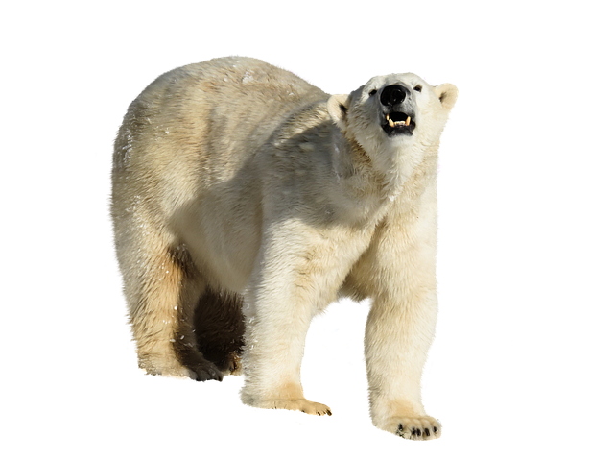

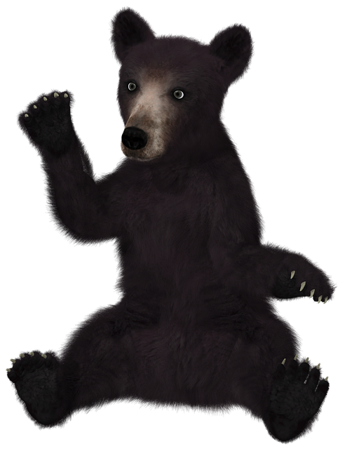
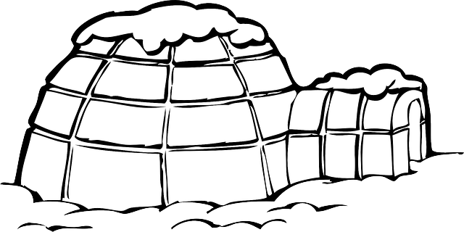
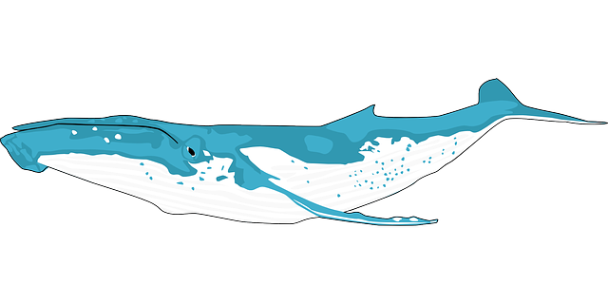
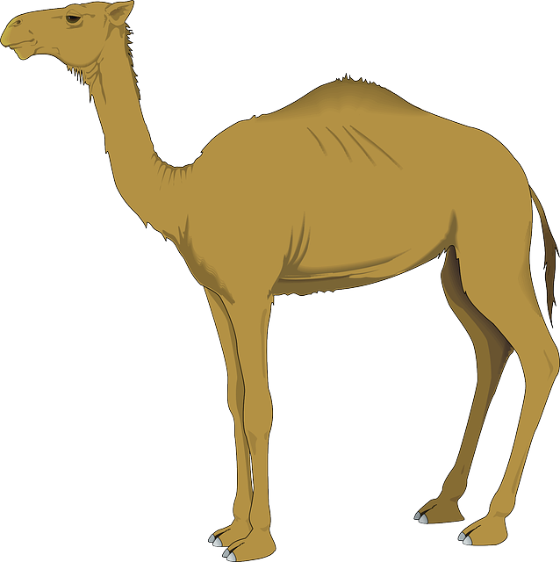
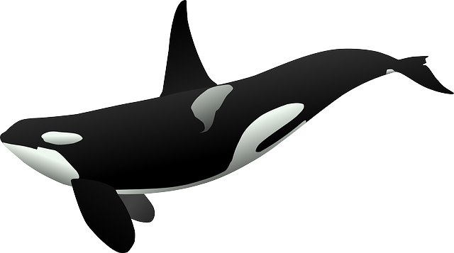
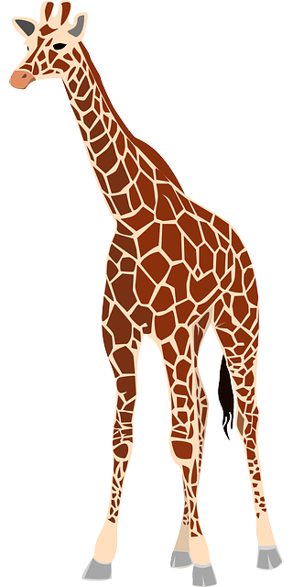
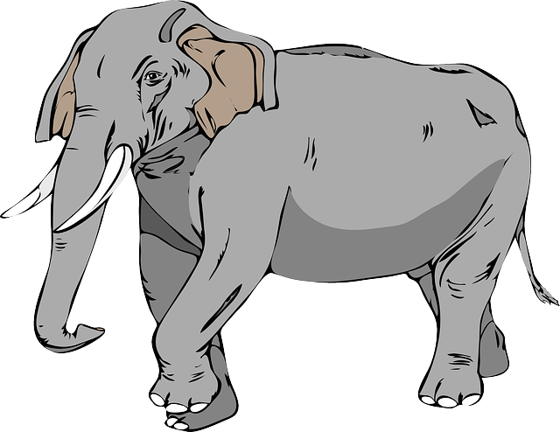
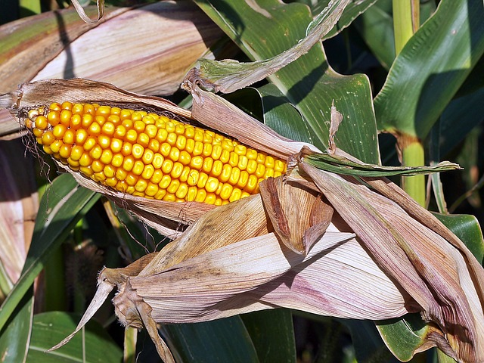
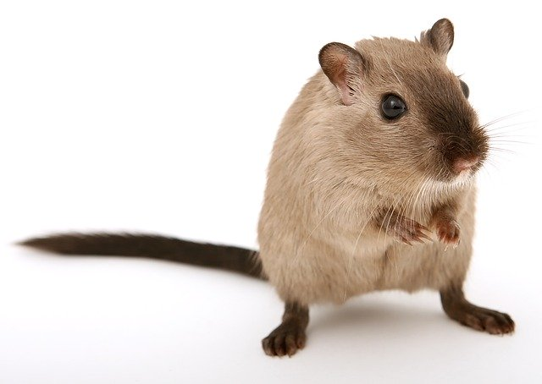
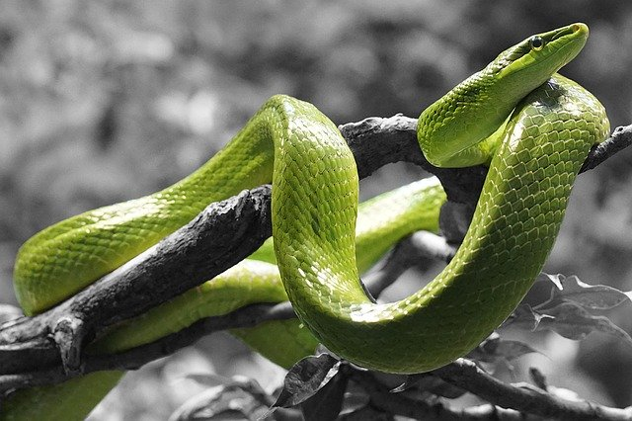
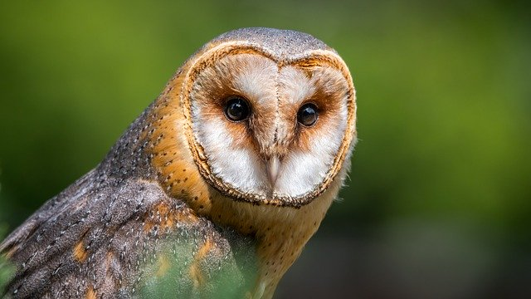
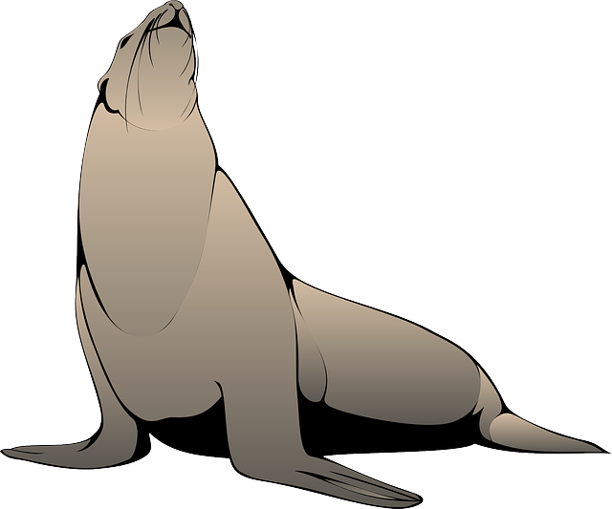
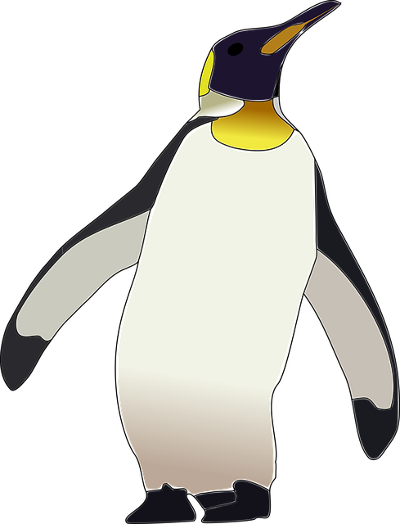

Year 2 Knowledge Organiser
Unit: Habitats Around the World
Did you know
?
What is a microhabitat?
Microhabitats are very small habitats where minibeasts may live. Examples of microhabitats include under stones, in grass, under fallen leaves and in the soil. Minibeasts that can be found there include worms, snails, ants, centipedes, millipedes, and butterflies and they help to keep the microhabitat healthy. Minibeasts are able to survive in their habitats because they can find the things they need to survive there, such as food and water. For example, caterpillars can survive on leaves as they give them food.
Animals and plants depend on each other to survive. For example, worms depend on plants because they feed on dead leaves, but plants depend on worms who make the soil healthy by digging holes and allowing air in. Birds also need worms because they eat them. Worms are a source of food for birds. This called a food chain. If there were no worms, there would be less birds as there would be more competition for food. The soil would not be as healthy without worms. All living things (or things that were once living) have a part to play in food chains. Without them, other animals and plants may not be able to survive.
Unit Lessons
Know that living things live in environments to which they are suited
Appreciate that environments are constantly changing
Describe life in the ocean
Appreciate the dangers of ocean life
Explore the Arctic and Antarctic habitat
Explore the rainforest and its problems
Understand desert, underground and ocean habitats
A habitat is a place where living things, such as animals and plants, can find all of the things they need to survive. This includes food, water, air, space to move and grow and some shelter.
Some habitats are large, like the ocean, and some are very small, such as under a log.
Some habitats in our local area include the river and woodlands. Other habitats include the coast and the forest.
Everyday Materials

