Slide 1
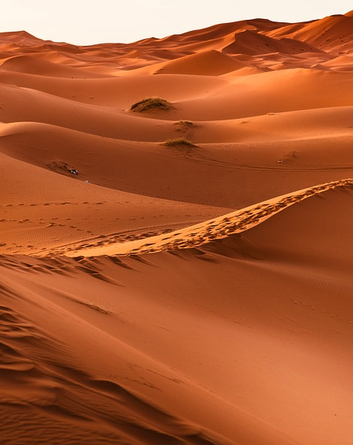
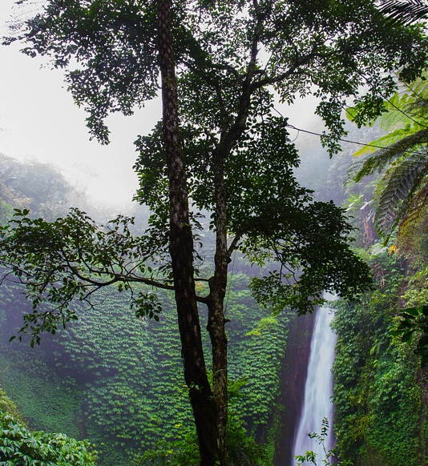
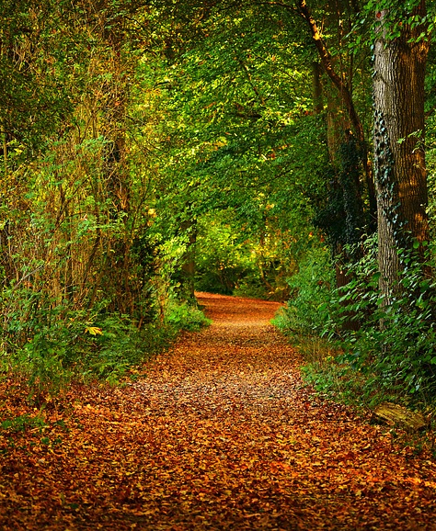
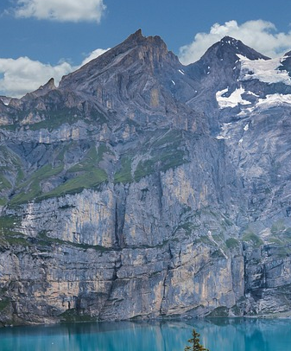
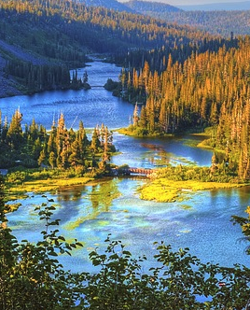
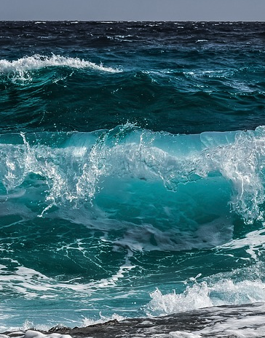

Year 2 Knowledge Organiser
Unit: Living things & their habitats
Did you know
?
GR8! – 8 words and meanings to learn
Key Word | Meaning
1. habitat | The natural area or place where an animal or plant lives.
2. desert | An area covered by sand and rocks with very little water or plants.
3. woodland | A land on which many trees grow which is home to many animals.
4. producer | A plant is an example of this because it uses the sun to make its own food.
5. root vegetable | The fleshy root of a plant used as a vegetable such as a carrot, swede, or beetroot.
6. living | Alive.
7. excrete | To give out cellular waste from the body usually as urine or sweat.
8. microhabitat | A small home or habitat which is slightly different from some surrounding more extensive habitat.
Thousands of new species of plants and animals are discovered every year.
Unit Lessons
Explore the differences between things that are living, dead and things that have never been alive
Identify and name a variety of plants and animals in a microhabitats
Describe how animals obtain their food from plants
Understand the journey food makes from the farm to the supermarket
Identify and name different sources of healthy food
Learn about the food chain
Many animals and plants have changed over time to adapt to their habitat.
Farmers are busy all year round preparing the ground and growing crops, as well as looking after animals and breeding animals.
A microhabitat is a small area which differs somehow from the surrounding habitat.
Some habitats
desert
rainforest
woodland
mountain
river
ocean

